Slide 1
DELE CA1
(Group 6)
Done by Ying Wen, Charan, Mark

Slide 2
About the dataset
The telematics data collected during driving trips are useful to detect if the trip is dangerous and has high crash / accident probability.
The data captures information from all directions, which some may or may not be useful.

Slide 3
Data Cleaning
Balance the dataset base on the label(0 or 1)
Checking for null values

Slide 4
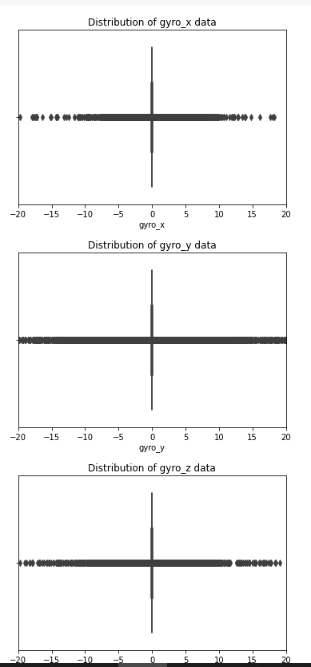
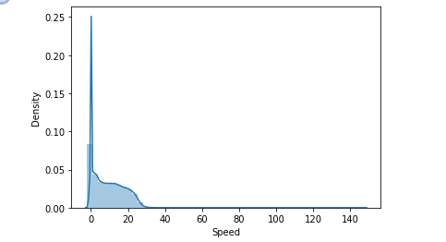
Data Exploration

Slide 5
Feature Engineering
New column dist by multiplying speed with seconds
PCA on gyro x, y and z, gyro x can explain the variation in gyroscope data fairly well, thus only keep gyro x
PCA on acceleration x, y and z, acce x can explain the variation in acceleration data fairly well, thus only keep acceleration x

Slide 6
Model Building
Learning rate reduction was used to change the learning rate if the accuracy remains the same for a few epoch this would improve accuracy of the model

Slide 7
Model Evaluation
We evaluated the model by using the error percentage and evaluated how the model is faring

Slide 8

Thank you

